Slide 1
Sparse View CT Reconstruction Based on a Dual-domain Convolutional Neural Network
CS766 Final Presentation
Xin Tie, Minyi Dai, Hao Zhang

Slide 2
Outline
Introduction
Method
Results
Summary

Slide 3
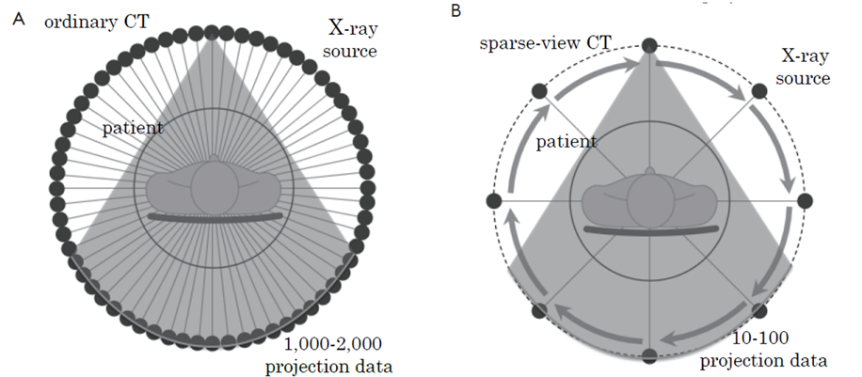
Introduction
In the medical domain, image reconstruction commonly assumes that the imaged object remain stationary.
It does not hold in scenarios involving dynamic imaging.
Sparse-view CT: reduce radiation dose, reduce scan time, improve the time-resolving capability in the cardiac CT.
Notes:
In the medical domain, image reconstruction commonly assumes that the imaged object remains stationary throughout the acquisition. However, this assumption does not hold in scenarios involving dynamic imaging. Failure to consider the motion of the imaged object can result in the appearance of motion artifacts, which could adversely impact the radiologist's diagnosis. To solve the issue in dynamic imaging, one way is to reduce the amount of required data for reconstruction. Here comes the topic for today’s presentation - sparse-view CT. First, let briefly talk about the ordinary fan-beam CT that is shown on the left, projection data is measured from 1000 to 2000 X-ray source positions uniformly distributed over 0 to 2pi. In the sparse-view CT, the number of projection data is reduced to roughly 100 views or even less depending on the applications and required image quality. It brings the benefits, including reducing radiation dose, reducing scan time and improving the time-resolving capability in the cardiac CT.

Slide 4
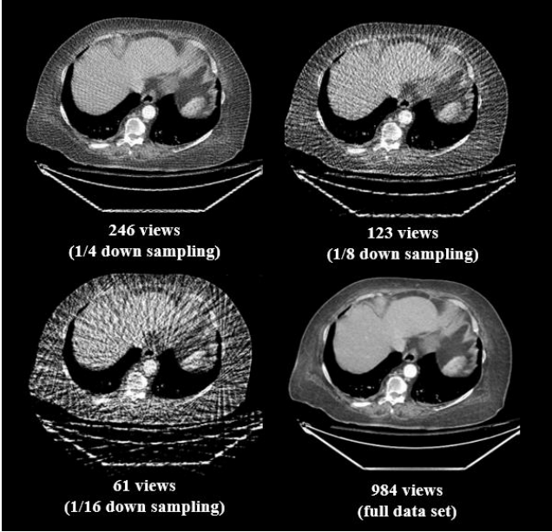
Introduction
Challenges
Aliasing artifacts (appear as streaks)
Increased noise
As the number of acquired view angles decreases, the resulting artifacts become more pronounced.
Notes:
The main challenge in sparse-view reconstruction is angular undersampling that violates Nyquist’s criterion, causing aliasing artifacts [3]. These artifacts manifest as streaks in the CT images. As the number of acquired view projection data decreases, the resulting artifacts become more pronounced, as shown in the figure on the left.

Slide 5
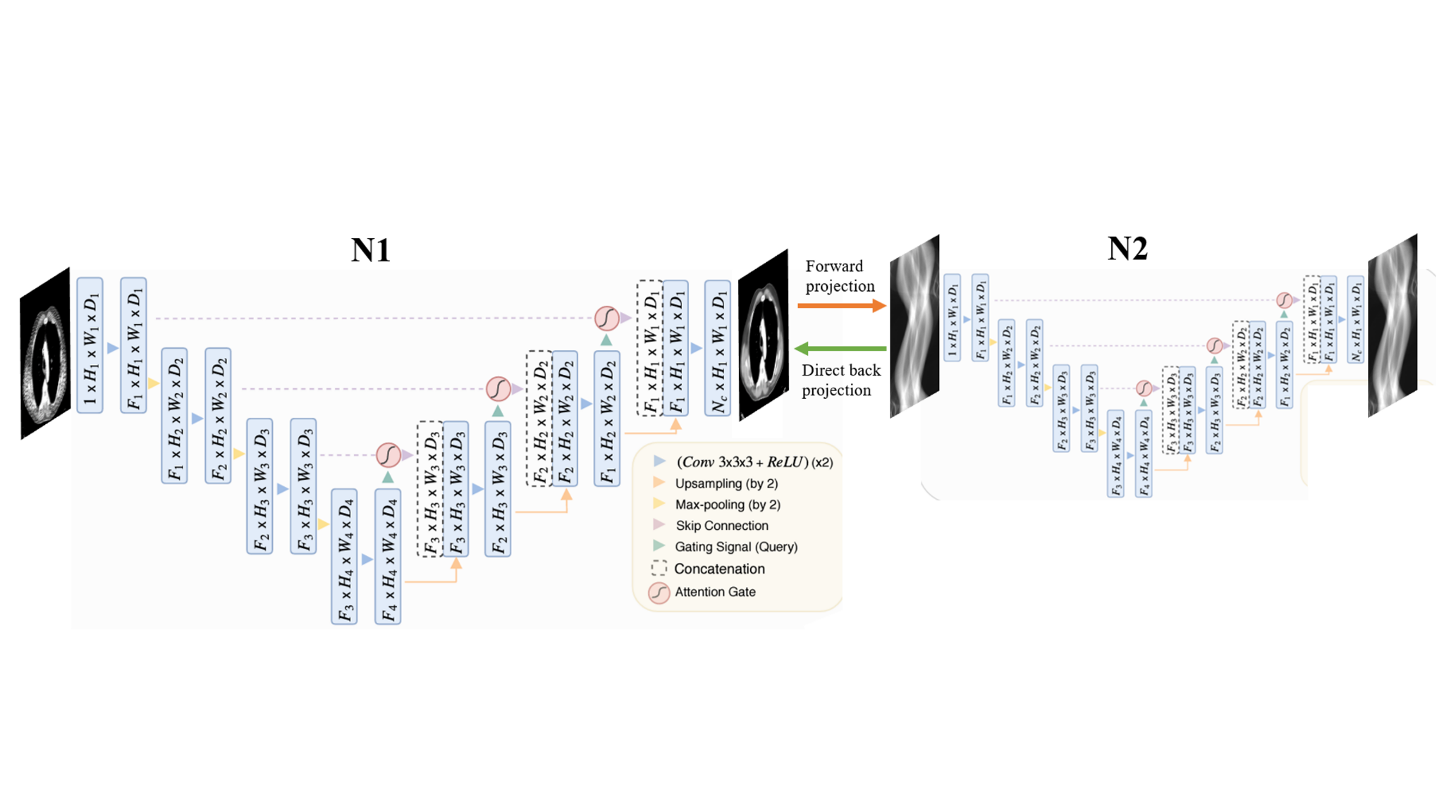
Methods
Undersampled images to reconstructed images with full data through an Attention-UNet
Undersampled sinogram to fully sampled sinogram through an Attention-UNet

Slide 6
Methods
From N1 to N2, the estimated signogram is replaced by measured sparse-view data.
Loss function: least square loss and the gradient loss for both images and signograms.
Model training process:
The mini-batch size was set as 8, and 200 epochs were used. The ADAM optimizer with an initial learning rate of 1e-4 was empirically selected. If there was no decrease in the validation loss for 10 consecutive epochs, the learning rate was reduced by a factor of 0.2. This process was repeated until the learning rate reached 1e-6.

Slide 7
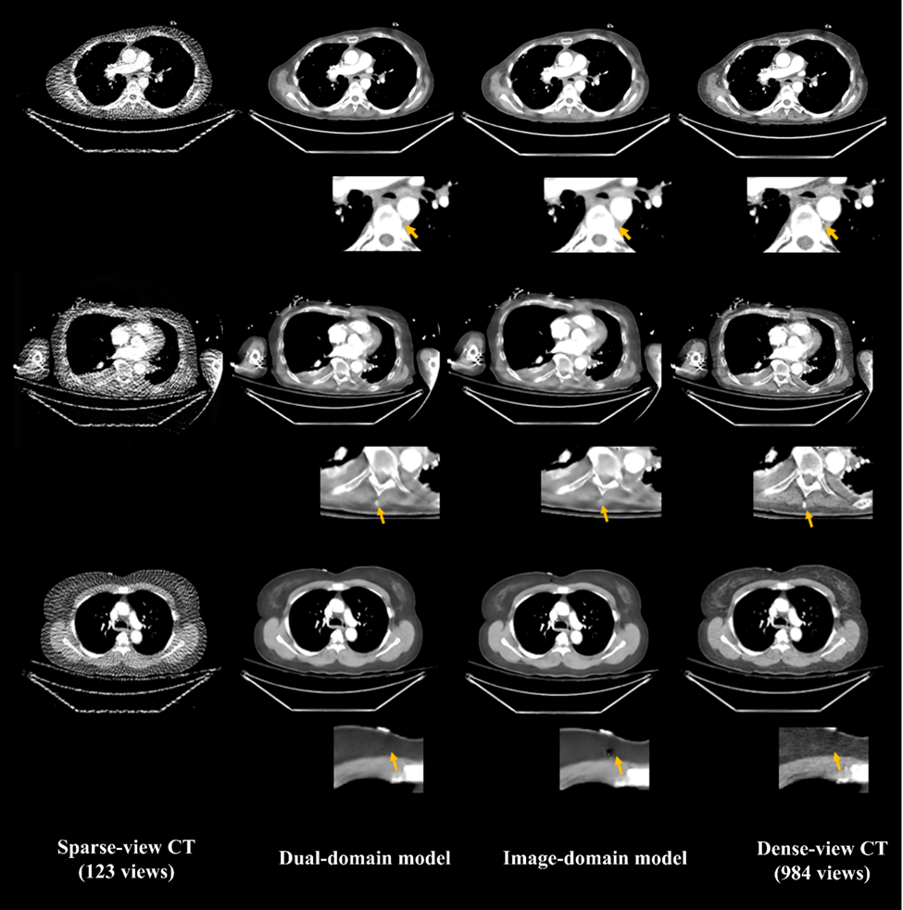

Results
Notes:
Now, let’s look at some results we generated using our dual-domain model. The resulting image demonstrates that the streak artifacts present in the original sparse-view image on the left have been effectively removed, and the anatomical structured are well-preserved. In this case, the pure image-domain model also did a good job in eliminating the artifacts, but it tends to overly smooth the images, as shown in the zoomed-in region.

Slide 8
Results
Notes:
This is another case showing the superior preservation of tiny and high-contrast objects by the dual-domain model. These ting structures are sometime quite important to clinical diagnosis. And we definitely do not want to miss it.

Slide 9
Results
Notes:
When we evaluate our results, we find that some images generated by the image-domain model have some spurious structures that appear as dark clusters, but the dual-domain model does not have such issues. Our guess is that the additional information introduced by the sinogram could regularize the training and avoid adding some false positive structures.

Slide 10
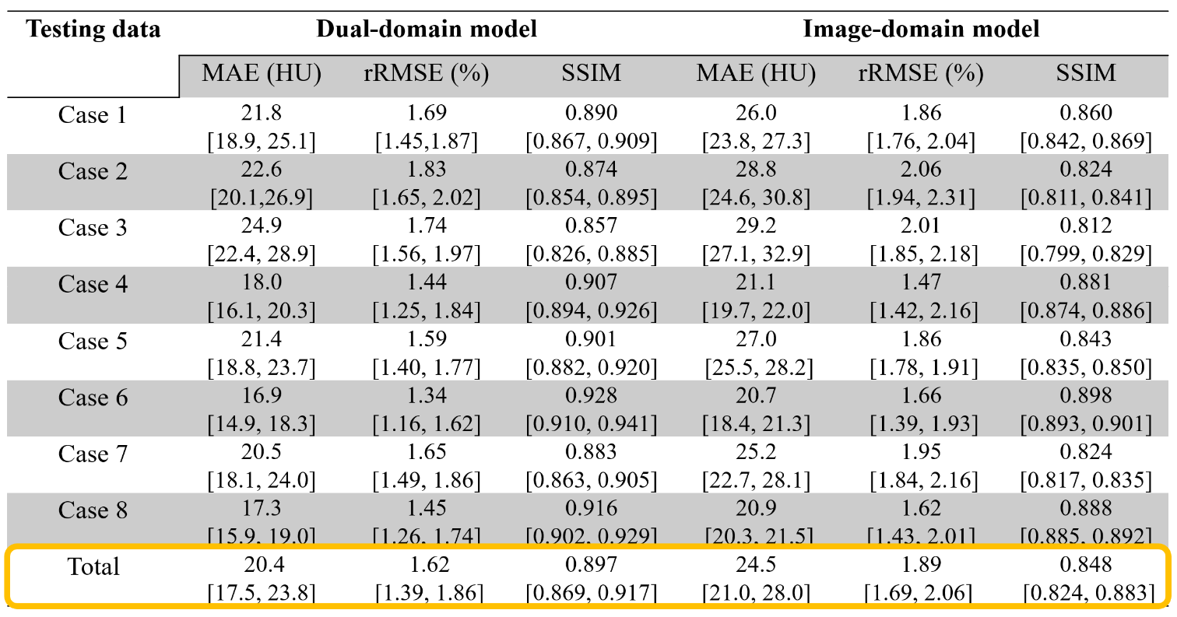
Results
Notes:
This table summarizes the quantitative results obtained by each model on 8 testing cases. We observe that the dual-domain model achieved consistently better results across all evaluation metrics, including the pixel-wise metrics, like mean absolute errors, relative RMSE and the structure-based metric, like SSIM.

Slide 11
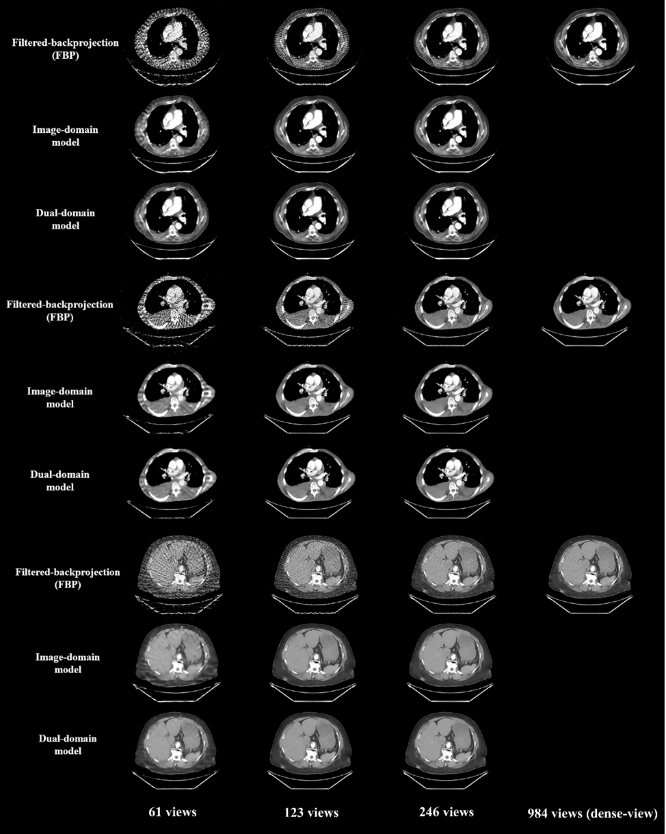
Results
Notes:
We also tested our model when more view angles or fewer view angles are sampled. Generally, when more view angles are acquired, our model does not over-correct the image, causing shift of CT numbers or loss of spatial resolution, which is sometime observed in the CT denoising network. In scenarios where the acquired data is only 1/16th of the entire data set, that is 61 views, severe artifacts make anatomical structures extremely difficult to identify in the conventional FBP images. Both methods reduce the streaks and restore some structures, but overall even the dual domain model is not quite successful since the residual artifacts still persist.

Slide 12
Summary
We present a dual-domain method that initially corrects the artifact-contaminated images and then proceeds with a sinogram-domain model to enhance the accuracy of the reconstructed images.
It demonstrates a greater capacity to reduce streak artifacts and restore anatomical structures.
The residual artifacts persist when the acquired data is only 1/16th of the complete data set.
Future studies:
Explore a more efficient approach to address the challenges in extremely undersampled tasks by incorporating the recently proposed and highly effective diffusion-based methods.
Notes:
When we apply our model to the data that is only 1/16th of the complete data set, our model is not quite suceessful with some residual artifacts present. In future, we are going to ...

